Slide 1


COPORATE STRATEGY 2025
Hermès
Mathis Sassolas M2 DADEE

Slide 2
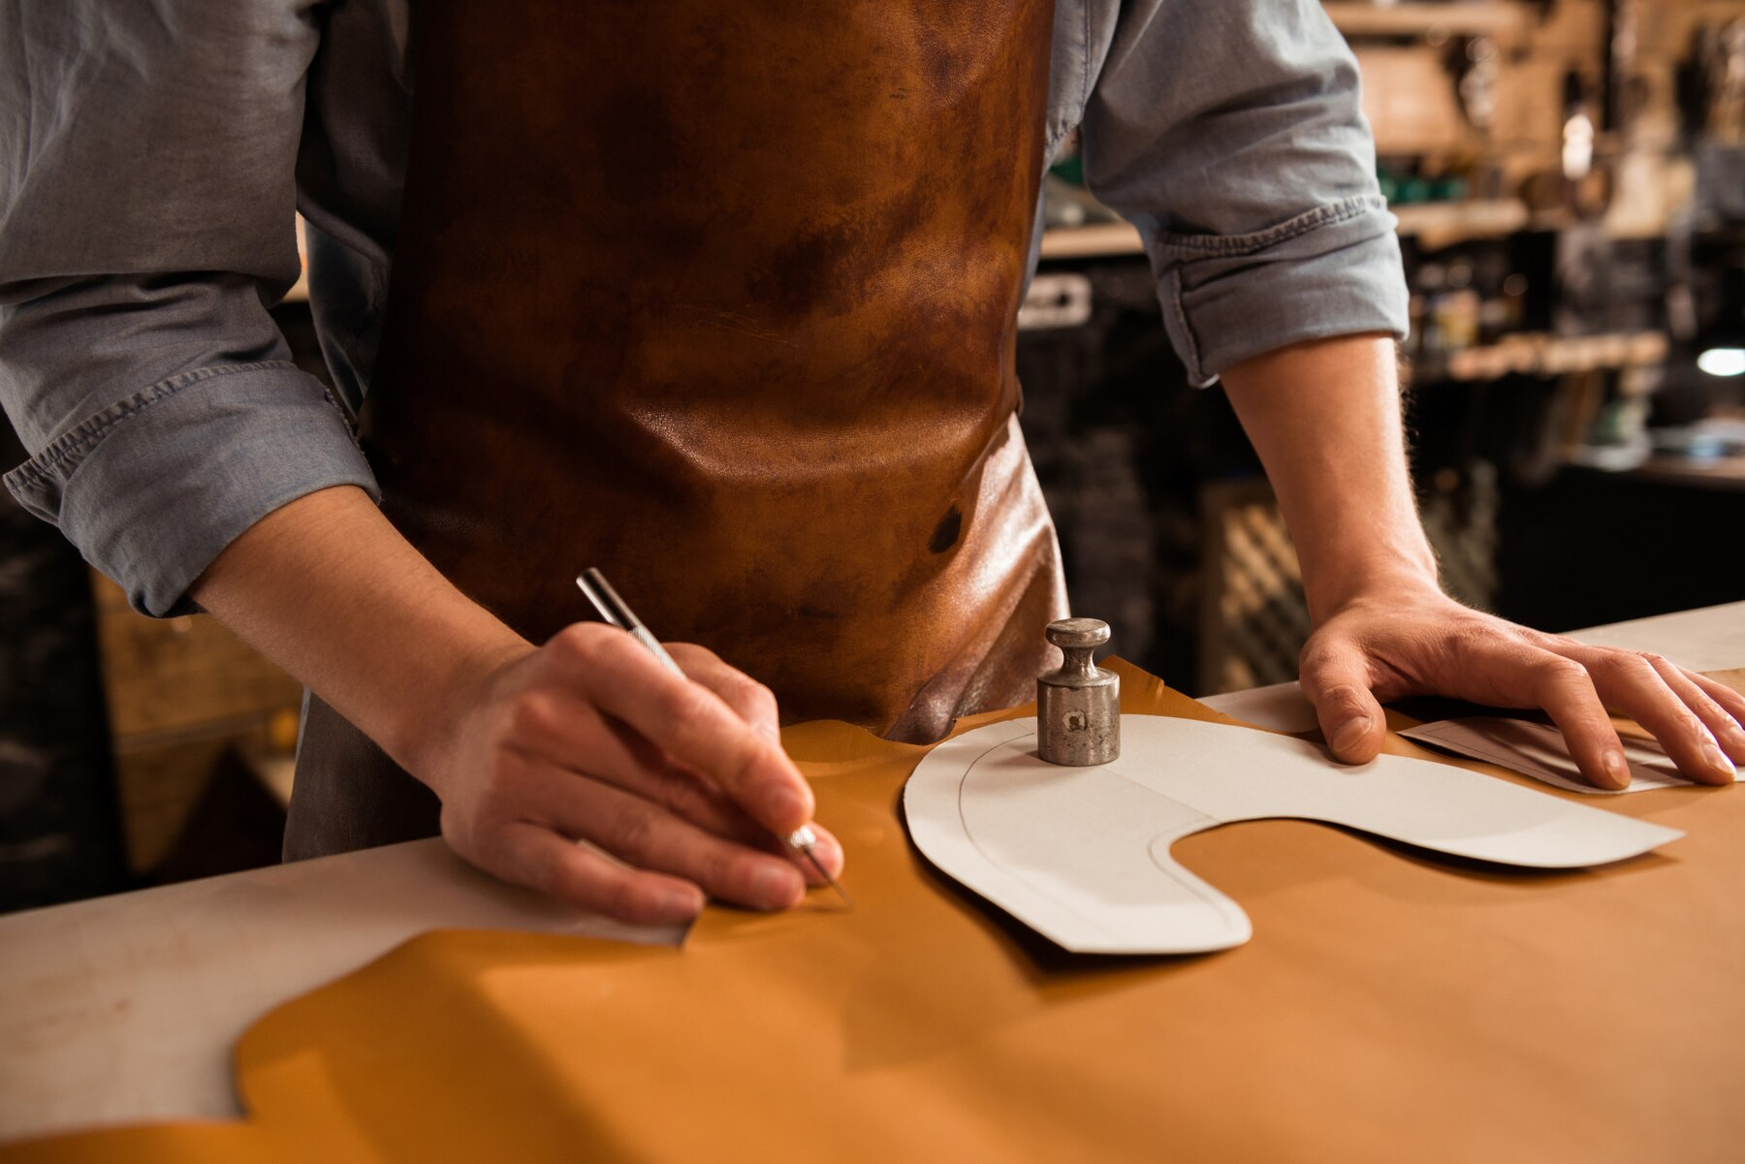

1
Context
2
Competition
3
SWOT
4
Main risk
5
Income Statment
6
Solution
7
Conclusion

Slide 3
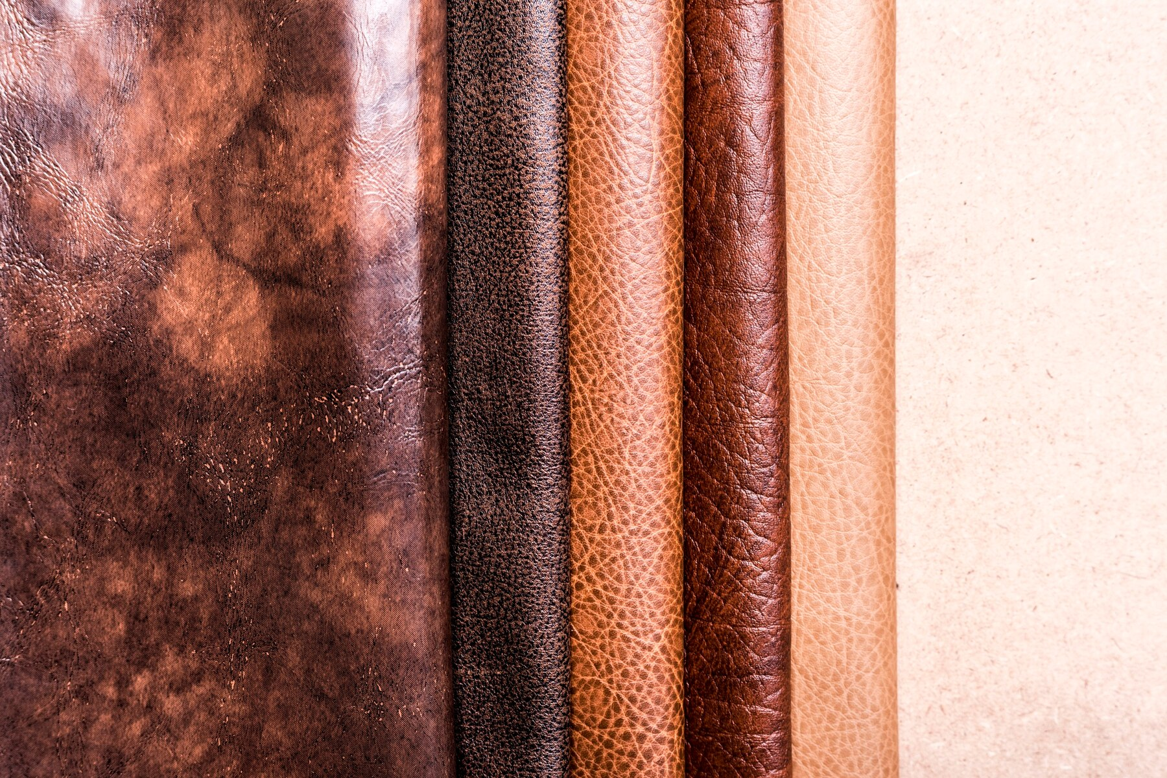
01
Context

Slide 4

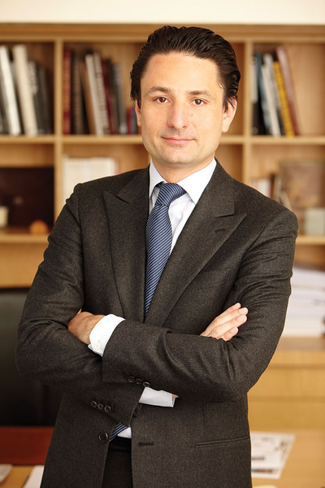
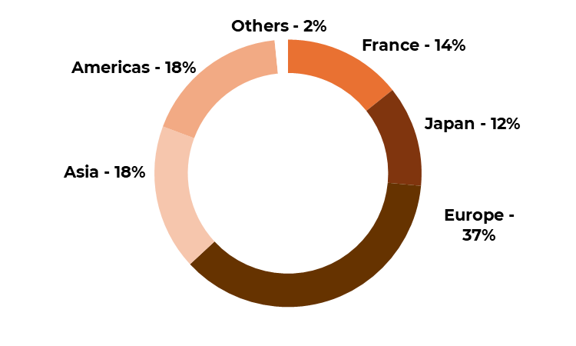
7 questions and statement about the company
What is it ?
A French luxury house specializing in handcrafted leather goods, fashion, watches, jewelry, and fragrances.
Fundation : When and who?
Presence
Founded in 1837 by Thierry Hermès. It was initially a saddlery business, before expanding into luxury fashion and accessories. Nowadays the company is still family owned and run by its CEO Axel Dumas
The company is headquartered in Paris and has boutiques in most countries in North America, Europe, Asia.
Geographical Repatition of Sales (2015)

Slide 5
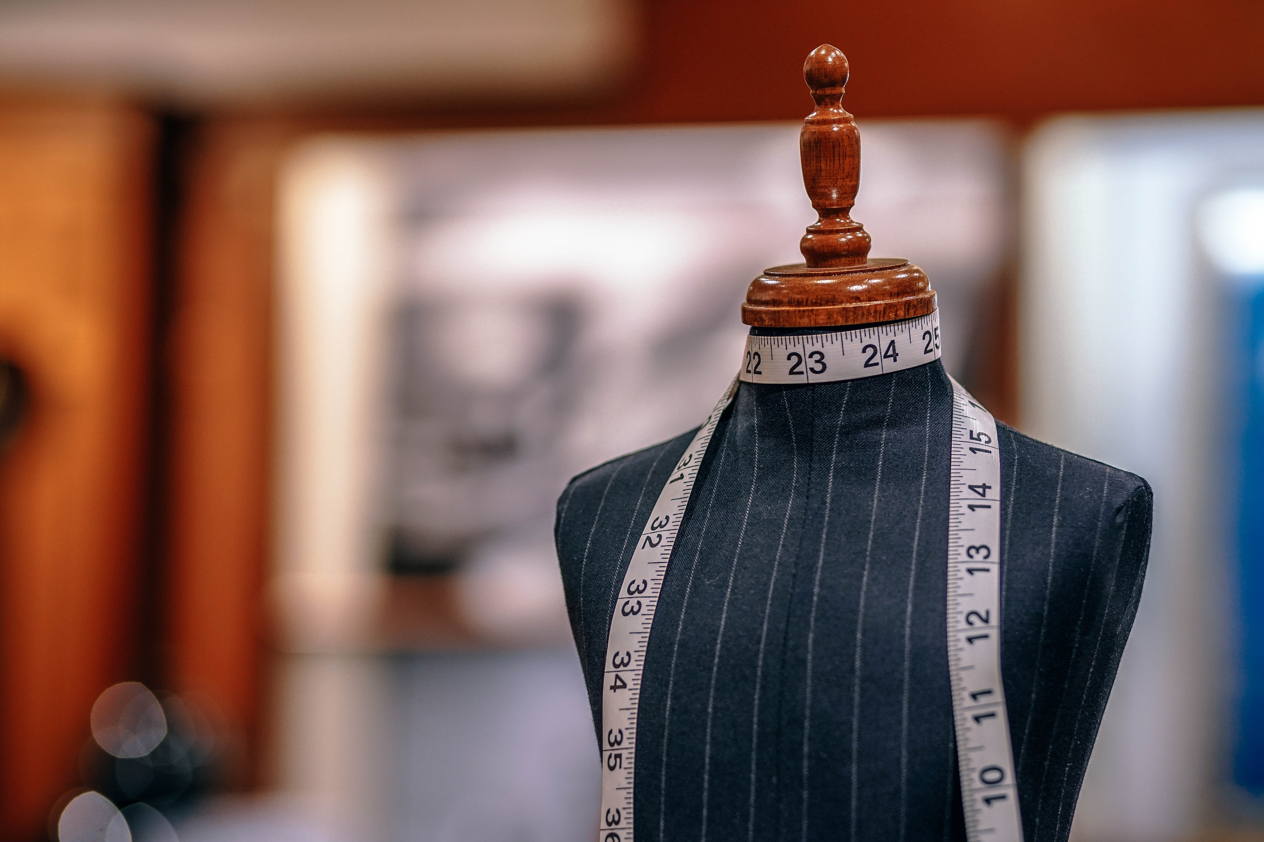
How does the strategy work
How much ?
Maintain a luxury status through handmade craftmanship, strict supply chain control, and limited production to ensure exclusivity. The brand owns its own tanneries to secure top-quality products
It avoid mass production and, discounts and trend-driven designs.
The main streams of income are the sales of lather good (50% of revenue).
Other sources of income include ready-to-wear, perfumes and jewelry.

Slide 6
02
Position relative to competitors

Slide 7


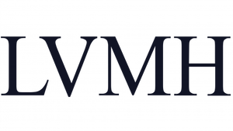
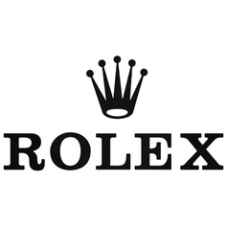
LOW COST
DIFFERENTIATION
TOTAL
MARKET
COST LEADERSHIP
DIFFERENCIATION
COST FOCUS
DIFFERENCIATION FOCUS
NICHE
MARKET

Slide 8

HIGH
WTP
LOW
HIGH
RELATIVE COST POSITION
LOW

Slide 9
03
Strength, Weakness, Opportunities & Threats (SWOT)

Slide 10
Vertical Intergration
Heritage & Exclusivity
Uniqueness of products due to handmade craftmanship
Strong financial performances
Limited production capacity
High dependence on leather goods
Slow digital and e-commerce adoption compared to competitors
Limited customers base because of high entry prices
S
W
Expansion in Emerging markets due to increased standards of living.
The development of eco-friendly luxury good for sustainable practices.
Counterfeiting and imitations.
Regulatory & Ethical issues around animal-derived materials
End of the post-pandemic luxury surge, which was driven by accumulated savings.
Economic slowdown of China
O
T

Slide 11
Vertical Intergration
Heritage & Exclusivity
Uniqueness of products due to handmade craftmanship
Strong financial performances
Limited production capacity
High dependence on leather goods
Slow digital and e-commerce adoption compared to competitors
Limited customers base because of high entry price
S
W
Expansion in Emerging markets due to increased standards of living.
The development of eco-friendly luxury good for sustainable practices.
Counterfeiting and imitations.
Regulatory & Ethical issues around animal-derived materials
End of the post-pandemic luxury surge, which was driven by accumulated savings.
Economic slowdown of China
O
T

Slide 12
04
A potential risk : the end of Chinese consumption of French Luxury ?

Slide 13
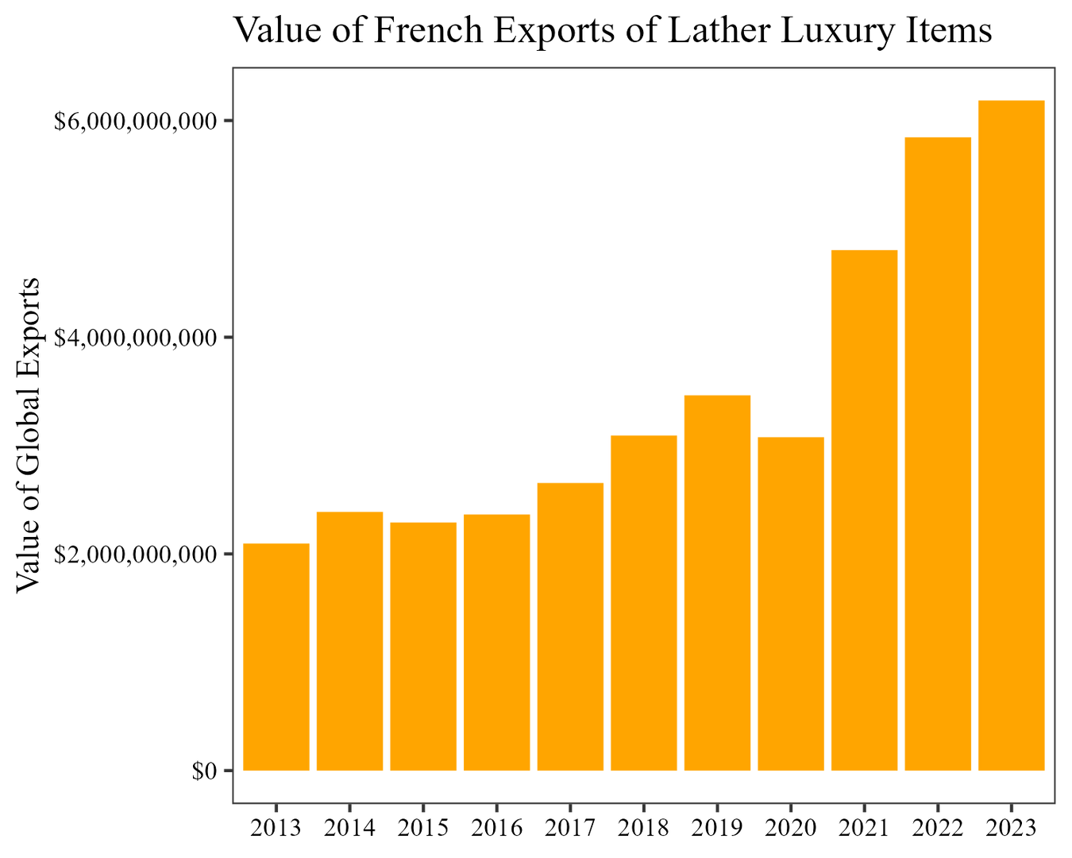
Risk : the end of the post-pandemic Luxury boom
Post pandemic crisis characterized by a boom in the luxury industry.
Several factors explain this phenomena such as : large amount of saving, the shift from experiences to goods during lockdowns or stock gains and wealth effect.
By the end of 2021, the sales have stabilized.

Slide 14
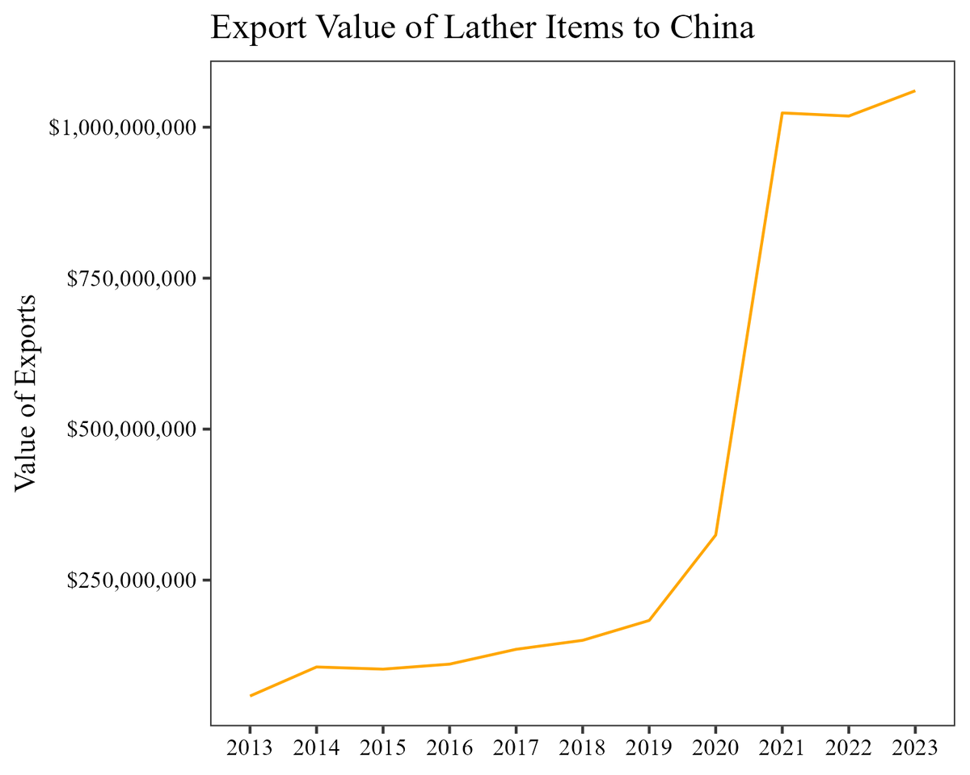

Risk : the end of the post-pandemic Luxury boom
Big players in emerging markets, such as China contributed to this rise of Luxury industry.
The stagnation that appears at the end of 2021 in the country is even more striking.
This is mainly due to lower purshasing power and decelerated economic growth which impacted negatively consumer confidence.
Source : UNCOMTRADE data on french exports

Slide 15
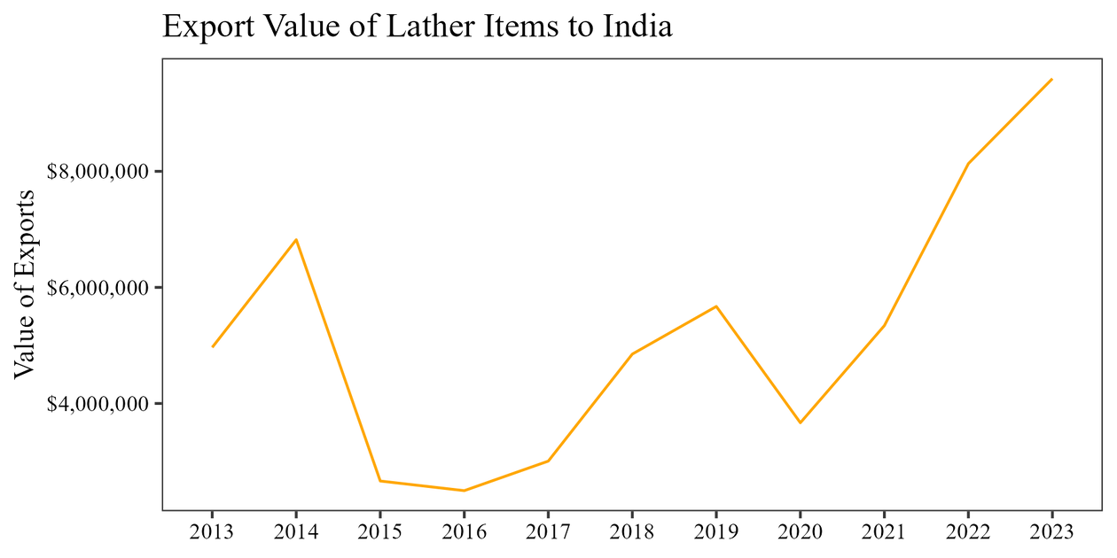

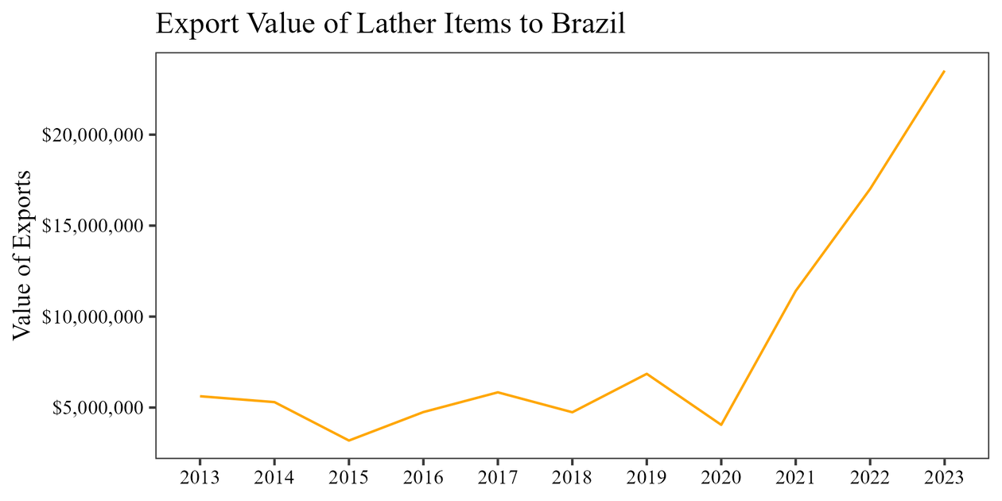
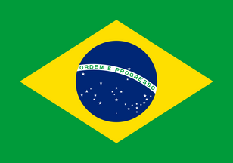
Risk : the end of the post-pandemic Luxury boom
Though the sector still performs well, it continues to expand rapidly into emerging economies.
For example, in Brazil and India, after a strong rise from the beginning of the Covid-19 crisis, French Leather Exports have continued to grow steadilty.
Despite the relative absence of Hermès in India, for example where it has only 2 boutiques against 15 in China
Source : UNCOMTRADE data on french exports

Slide 16
05
Income statement

Slide 17
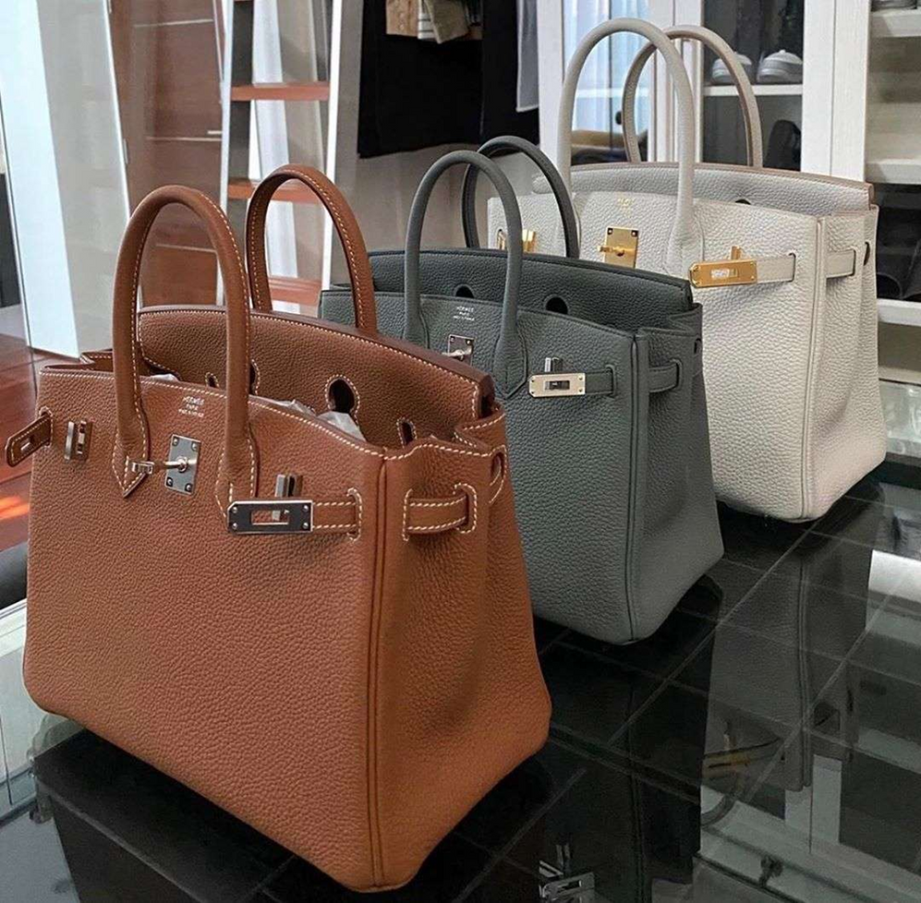
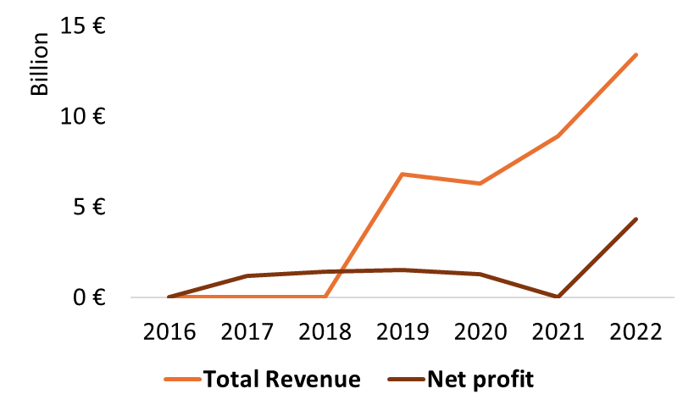
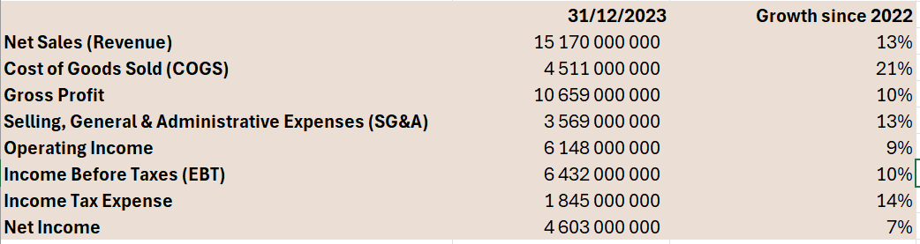
Income Statement
Evolution of Net Profit and Total Revenue
Source : annuaire des sociétés - Hermès international
Key financial indicators

Slide 18
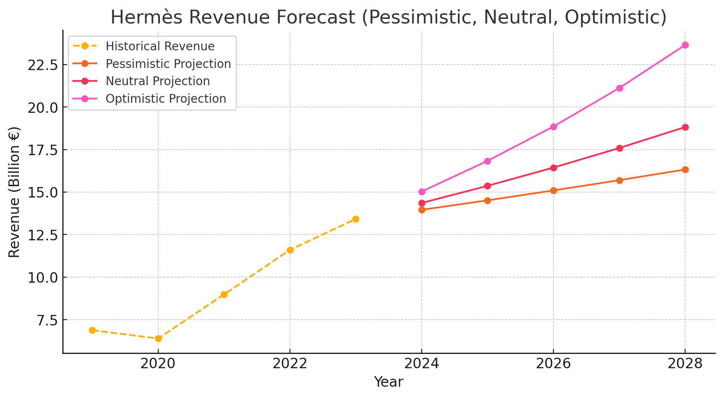
Forcasted revenues for 2028

Slide 19
06
Solution : reaching India

Slide 20
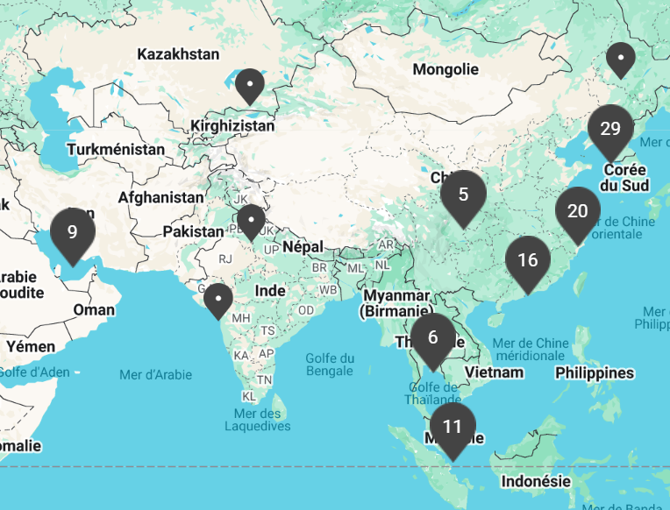
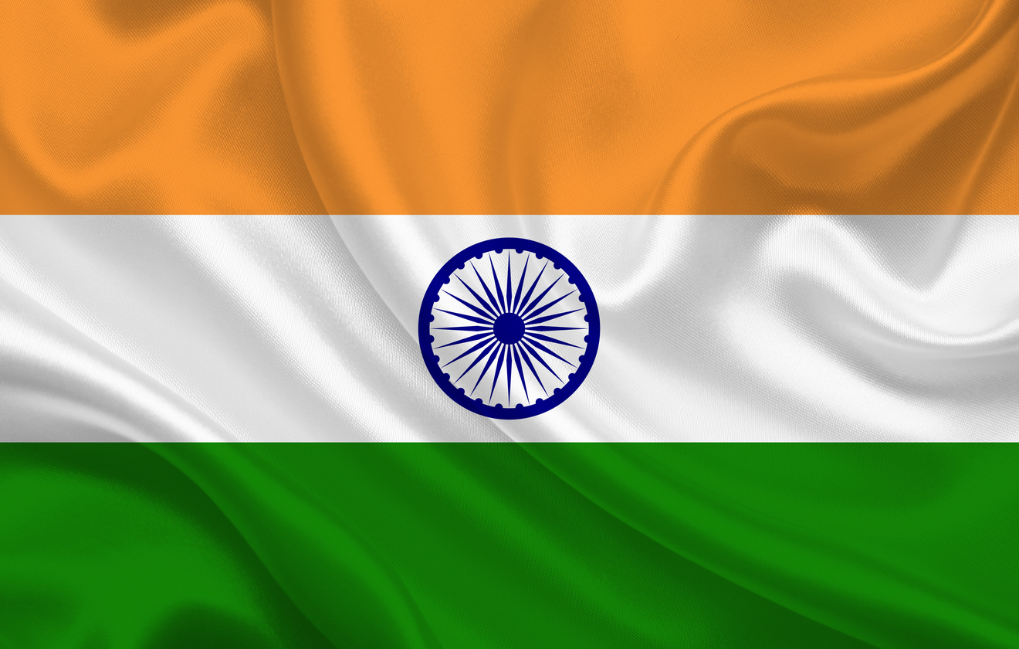
Solution : reaching India
Hermès has minimal presence in India, a rapidly growing luxury market with increasing ultra-high-net-worth individuals.
With China's slowdown, expanding into India offers a strategic opportunity to diversify and capture new affluent consumers.
By gradually entering key cities, launching exclusive India-inspired collections, and enhancing digital and VIP experiences, Hermès can establish itself as the leading ultra-luxury brand in this untapped market while maintaining exclusivity and prestige.

Slide 21
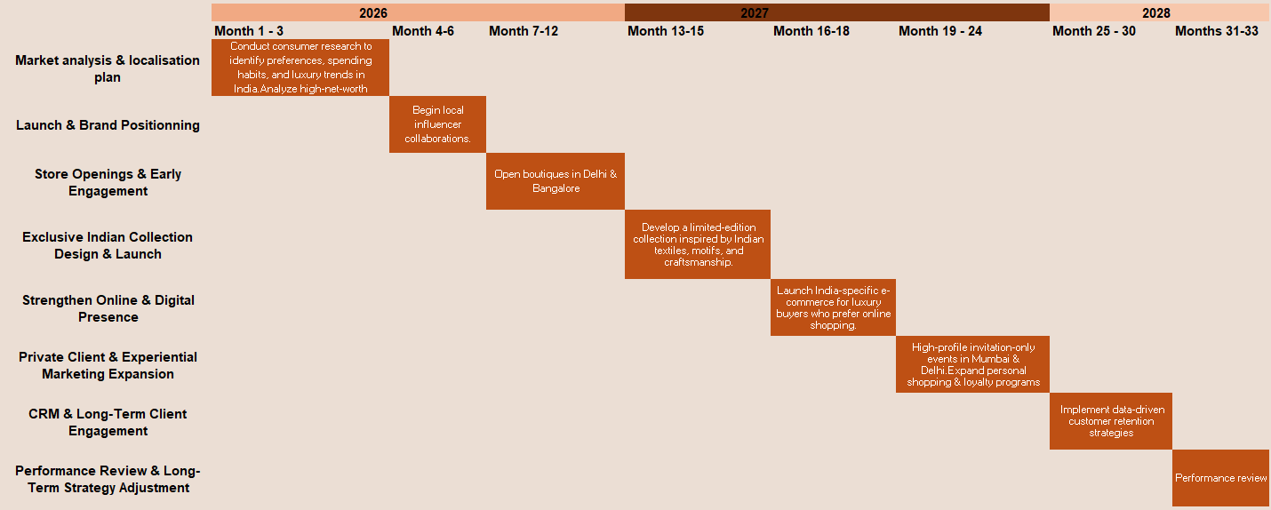
Solution : reaching India

Slide 22
07
Conclusion

Slide 23

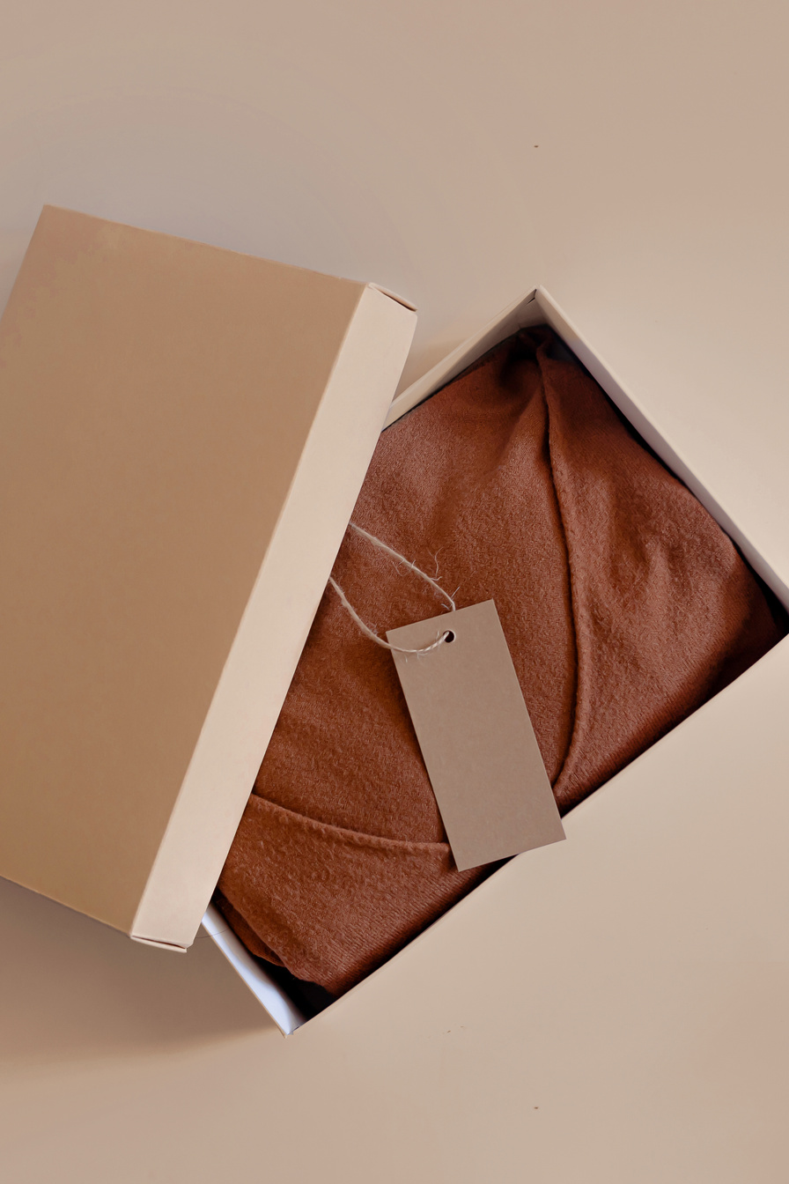
Conclusion
Optimistic outcomes can be excpected from the new implementation of the brand in India.
The revenue of the company made in India should increase by 30% within 3 years.
For a total cost of around 200 Million euros

Slide 24

Thank You!

